Slide 1
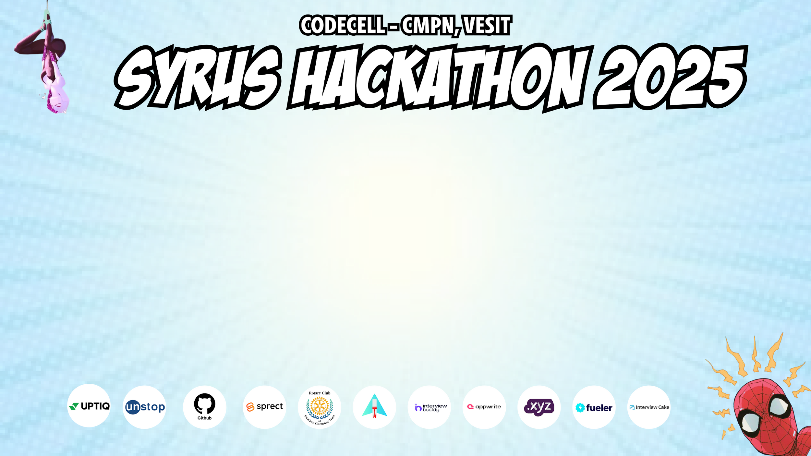
Category Code: C1
Problem Statement Title: Just Fair - Because every story matters
Team Name: AI DID MY CODE
Institute Name: Vivekanand Education Society’s Institute of Technology

Slide 2
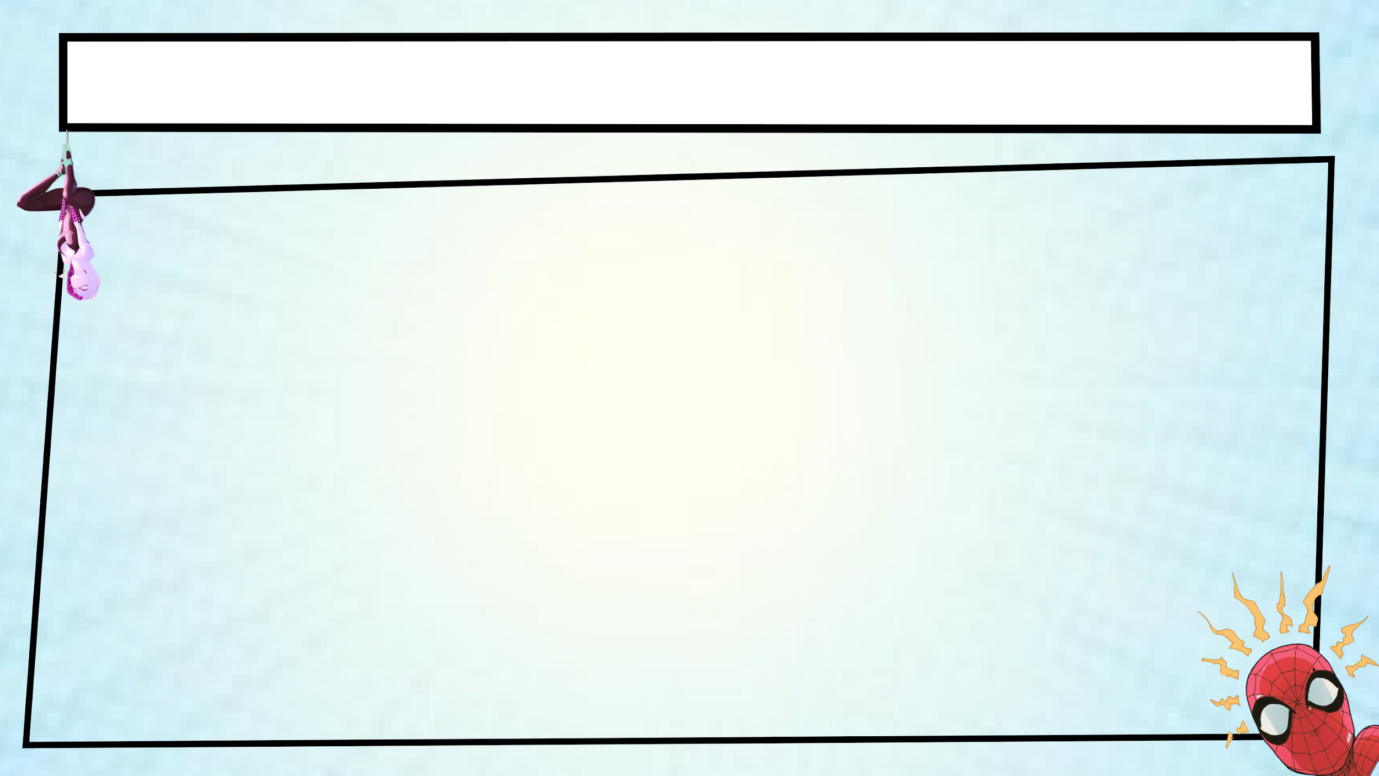
Idea / Approach details (& implemented features)
Idea:
JustFair provides AI-powered legal assistance for individuals facing false allegations.
Uses AI-driven case assessment, legal aid chatbot, and lawyer directory to offer affordable & accessible support.
Implemented Features:
AI Case Assessment – Analyzes case details & detects legal red flags. Legal Aid Chatbot – Provides instant legal guidance using NLP models. Lawyer & Therapist Directory – Connects users with verified professionals. User-Friendly Dashboard – Submit cases, track progress, and access resources.

Slide 3
Innovation (Showstopper)
What Makes JustFair Unique?
AI-Powered Legal Assistance: Uses machine learning to assess false allegations and provide data-driven insights.
Legal Aid Chatbot: 24/7 instant legal guidance using NLP, making legal help accessible to all.
Affordable & Scalable: Offers a free alternative to expensive legal consultations.
Mental Health Support Bot: Provides therapy backed emotional support.
Revolutionizing Legal Aid with AI – Because Every Story Matters!

Slide 4
Tech Stack
FRONTEND
BACKEND AND DATABASE
MACHINE LEARNING
Core Framework:
React
TypeScript
Vite
Styling:
Tailwind CSS
shadcn/ui
Routing
React Router DOM
Runtime: Node.js
Framework: Express.js
Authentication: JWT
Database: PostgreSQL
ORM/Database Management: Prisma
Model Used: Legal-BERT
LoRA
Hugging Face Trainer API
8-bit Model Optimization

Slide 5
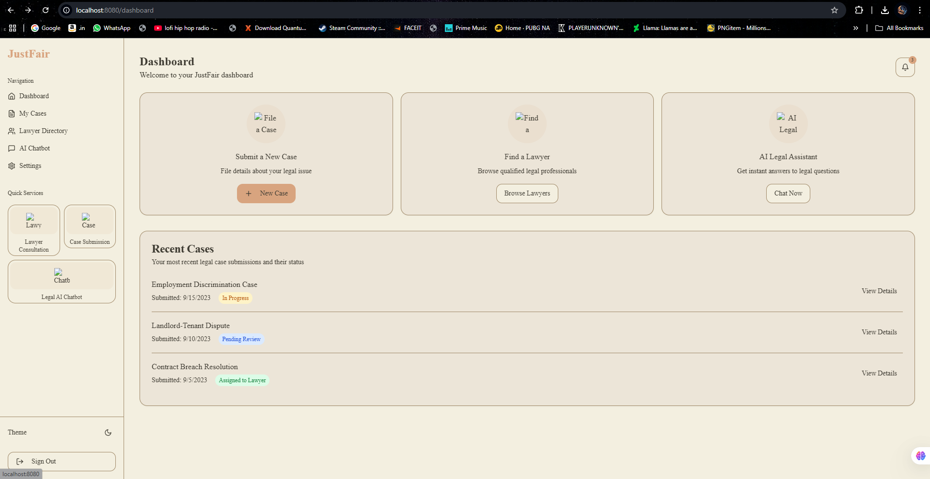
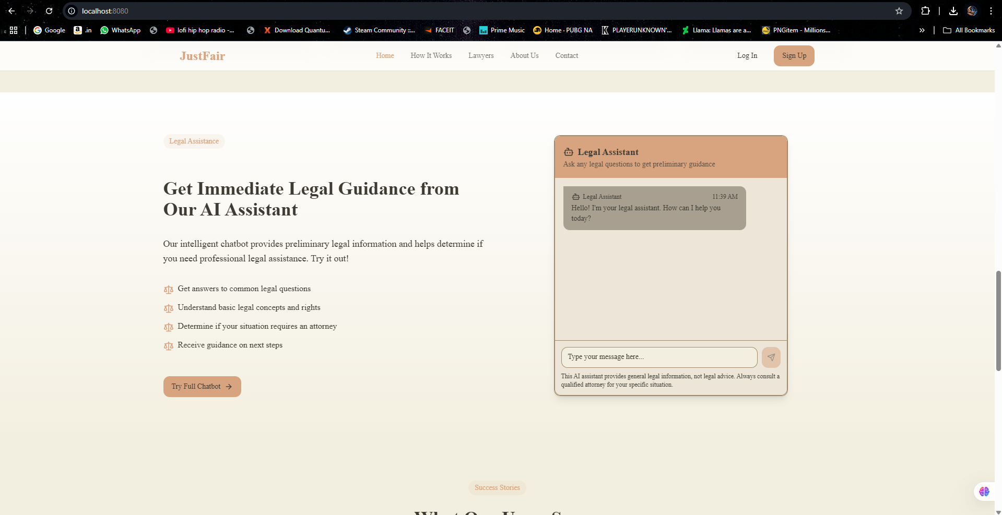
Implementation/Prototype/Use Case Diagram (screenshots)
Dashboard for the site
Dashboard for the site
Other Images : POSTGRESQL DB BACKEND SERVER

Slide 6
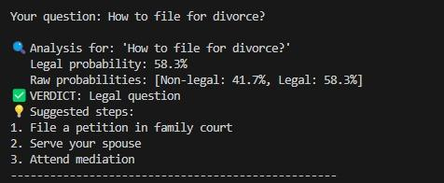
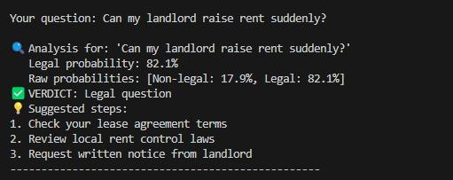
Implementation/Prototype/Use Case Diagram (screenshots)
OUTPUT OF TRAINED MODEL
OUTPUT OF TRAINED MODEL

Slide 7
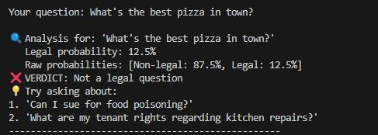
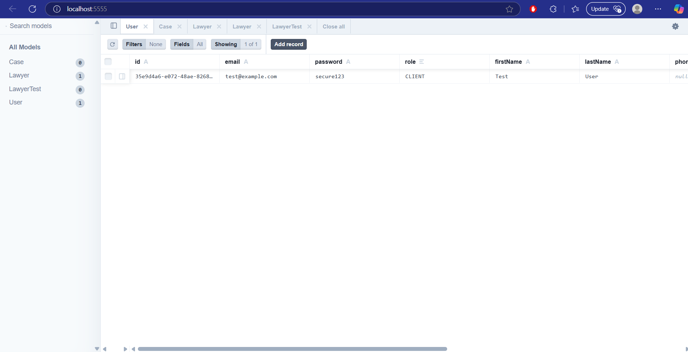
Implementation/Prototype/Use Case Diagram (screenshots)
OUTPUT OF TRAINED MODEL
LOCAL BACKEND SERVER

Slide 8
Implementation/Prototype/Use Case Diagram (screenshots)
Implementation / Prototype
Data Preprocessing: Cleaned legal texts (removed special characters, stopwords, lowercased).
Dataset Filtering: Extracted relevant cases from AILA dataset using keyword-based filtering (e.g., fraud, harassment, false allegations).
Tokenization: Used BERT tokenizer with padding, truncation (max_length=512).
Dataset Creation: Converted tokenized text to PyTorch tensors, split into train (80%) & validation (20%), and saved it.

Slide 9
Future Objectives
Backend Development – Build APIs to connect Legal-BERT with frontend, ensuring secure data handling.
Deployment & Implementation – Deploy model via Vercel, Railway and Supabase.
Backend-Frontend Integration – Connect AI services with chatbot for seamless user interactions.
Security & Compliance – Strengthen authentication & legal data privacy.

